Slide 1
Information Processing Techniques
Week 10
Abeeha Sattar

Slide 2
Windows Communication Foundation (WCF)

Slide 3




From Objects to Services
Object-Oriented
Polymorphism
Encapsulation
Subclassing
1980s
Component-Based
Interface-based
Dynamic Loading
Runtime Metadata
1990s
Service-Oriented
Message-based
Schema+Contract
Binding via Policy
2000s

Slide 4

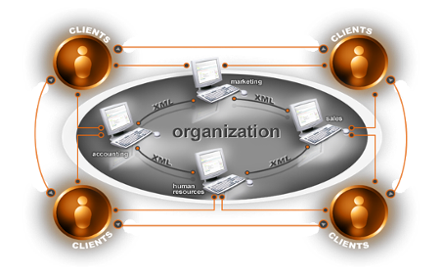
Challenges
Different programming models for different tasks
Need for security and reliable messaging
Interoperability with applications on other platforms
Productive service-oriented programming model needed

Slide 5
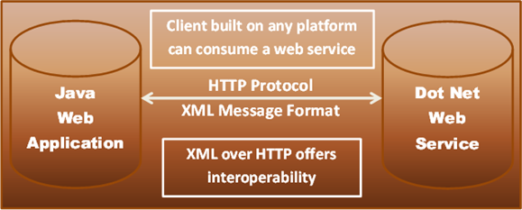
Example 1

Slide 6
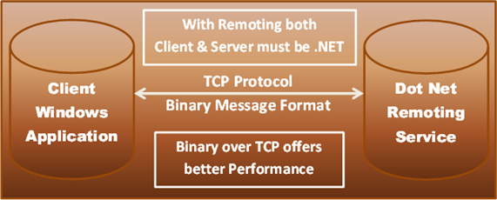
Example 2

Slide 7
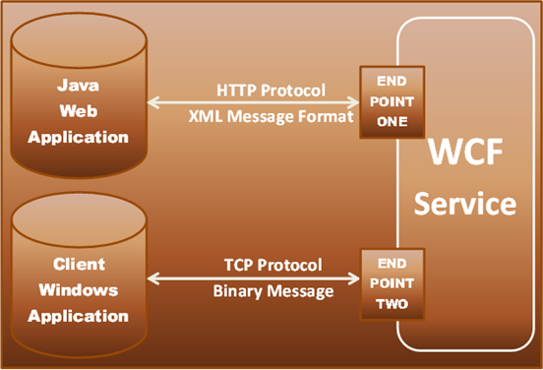
WCF Solution

Slide 8
What does WCF replace?
ASMX
WSE
.NET Remoting
COM+ (Enterprise Services)
MSMQ

Slide 9
Understanding WCF Principles

Slide 10




Services and Clients
Client
Service
Message
Message

Slide 11

Endpoints
Client
Service
Endpoint
Endpoint
Message
Endpoint

Slide 12







Address, Binding and Contracts
Client
Service
Endpoints
Endpoint
C
B
A
C
B
A
Message
C
B
A
Address
Binding
Contract
(Where)
(How)
(What)

Slide 13

WCF Architecture: Messaging Runtime
Service
Contract
and Behaviors
Client
Dispatcher
Protocol(s)
Protocol(s)
Binding
Encoder
Encoder
Transport
Transport
Address

Slide 14
Address (what)
Basically URL, specifies where this WCF service is hosted. Client will use this URL to connect to the service. e.g.
http://localhost:8090/MyService/SimpleCalculator.svc

Slide 15
Contracts (what)
Collection of operation that specifies what the endpoint will communicate with outside world. Usually name of the Interface will be mentioned in the Contract, so the client application will be aware of the operations which are exposed to the client. Each operation is a simple exchange pattern such as one-way, duplex and request/reply.

Slide 16
Three Types of Contracts
Service Contract
Defines Operations, Behaviors and Communication Shape
Data Contract
Defines Schema and Versioning Strategies
Message Contract
Allows defining application-specific headers and unwrapped body content
What does your service do
What object data is used
Allows control over the SOAP structure of messages

Slide 17
Service Contract
[ServiceContract]
public interface IService1
{
[OperationContract]
string GetData(int value);
[OperationContract]
CompositeType GetDataUsingDataContract(CompositeType composite);
[OperationContract]
int Sum(int a, int b);
}

Slide 18
Data Contracts
[DataContract]
public class CompositeType {
bool boolValue = true;
[DataMember] public bool BoolValue {
get { return boolValue; } set { boolValue = value; } }
}

Slide 19
Message Contracts
Message is the packet of data which contains important information. WCF uses these messages to transfer information from Source to destination.
WCF uses SOAP(Simple Object Access Protocol) Message format for communication. SOAP message contain Envelope, Header and Body. SOAP envelope contains name, namespace, header and body element. SOAP Header contain important information which are not directly related to message. SOAP body contains information which is used by the target.

Slide 20
Ways to Talk
One Way
One Way:
Datagram-style delivery
Request-Reply
Immediate Reply on same logical thread
Duplex
Reply “later” and on backchannel (callback-style)
Client
Service
Request-Reply
Duplex (Dual)

Slide 21
Service Contract (What does your service do?)
using System.ServiceModel;
[ServiceContract]
public interface ICalculate
{
[OperationContract]
double Add( double a, double b);
[OperationContract]
double Subtract( double a, double b);
}
Notes:
Note that boundaries are explicit. WCF will only publish methods that are decorated as part of the service.
Note that this can be declared inline on a class instance as well. This does not require that the end user declare the service contract via an interface.

Slide 22
Service Contract: OneWay
[ServiceContract]
public interface IOneWayCalculator
{
[OperationContract(IsOneWay=true)]
void StoreProblem (ComplexProblem p);
}

Slide 23
Service Contract: Duplex Asymmetric
[ServiceContract(Session=true,
CallbackContract=typeof(ICalculatorResults)]
public interface ICalculatorProblems
{
[OperationContract(IsOneWay=true)]
void SolveProblem (ComplexProblem p);
}
public interface ICalculatorResults
{
[OperationContract(IsOneWay=true)]
void Results(ComplexProblem p);
}

Slide 24
Data contracts (What object data needs to flow back and forth?)
[DataContract]
public class ComplexNumber
{
[DataMember] public double Real = 0.0D; [DataMember] public double Imaginary = 0.0D;
public ComplexNumber(double r, double i) { this.Real = r; this.Imaginary = i; }
}
Notes:
The operations of the contracts shown in the previous code examples accept only simple types as parameters and the return values are also simple types.
If you are dealing with parameter lists of that sort, it is likely that you will—for the most part—ignore the fact that the data you are exchanging between services is serialized from its in-memory object representation into an XML information set and subsequently encoded for the wire transfer (and vice versa, of course).
If you are dealing with predefined WSDL documents or if you want to use complex types as arguments, you need to give a little more consideration to the "data contract", however.
While a service contract defines the shape and rules for interfaces (portTypes), along with their associated messages and operations, the data contract defines the shape and rules for the data that is exchanged through operation's input and output messages.
The split between the data contract and the service contract is important.
Service contracts typically define a logically and semantically related set of operations grouped on an interface and are about how a service behaves.
The data contract defined information items that you flow across service boundaries and that are handled with additional logic on the provider and consumer side. If you were looking at it from a (English language) grammar perspective, you could consider operations to be the predicates and the data that flows are the objects, while the caller is the subject. Subjects can do a lot with objects. Every "do" is an operation.

Slide 25
Message contracts (Defines the mapping between the type and a SOAP envelope)
[MessageContract]
public class ComplexProblem
{
[MessageHeader] public string operation;
[MessageBody] public ComplexNumber n1;
[MessageBody] public ComplexNumber n2;
[MessageBody] public ComplexNumber solution;
// Constructors…
}
Notes:
SO principles mean that designers should plan to exchange messages rather than procedure calls.
The two styles of developing using WCF are RPC style where messages are generated using traditional procedure calls, but another mode of operation is available to users where they are cognizant of the messages being generated and want to control the SOAP encapsulation of the content that is being generated. Defining a message contract on a service means that the end user

Slide 26
Binding (how)
Binding
HTTP
Text
Security
Reliability
TX
Transport
Encoders
Protocol
TCP
HTTP
Text
Security
Reliability
MSMQ
IPC
Binary
TX
.NET
Custom
Custom
Custom
Notes:
TX = Transaction Protocol

Slide 27
Standard Bindings
Binding | Interop | Security | Session | TX | Duplex
BasicHttpBinding | BP 1.1 | N, T | N | N | n/a
WSHttpBinding | WS | M, T, X | N, T, RS | N, Yes | n/a
WSDualHttpBinding | WS | M | RS | N, Yes | Yes
WSFederationBinding | Federation | M | N, RS | N, Yes | No
NetTcpBinding | .NET | T, M | T ,RS | N, Yes | Yes
NetNamedPipeBinding | .NET | T | T, N | N, Yes | Yes
NetPeerTcpBinding | Peer | T | N | N | Yes
NetMsmqBinding | .NET | T, M, X | N | N, Yes | No
MsmqIntegrationBinding | MSMQ | T | N | N, Yes | n/a
N = None | T = Transport | M = Message | B = Both | RS = Reliable Sessions
Notes:
BasicHttpBinding: This is the basic web service for the communicate with a web server or a client application. It is designed to expose a WCF service as an asmx web service. This binding uses the HTTP protocol for communication.
NetMsmqBinding: It is used to implement message queuing in a WCF service. It enables a client application to send a message to a WCF service even if the service is unavailable.
NetTcpBinding: It allows the communication between a WCF service and a .NET client application over a network. It uses the TCP protocol and is a much faster and more reliable binding compared to HTTP protocol binding.
NetPeerTcpBinding: For peer-to-peer communication where messages are sent and received using the TCP protocol.
WSHttpBinding: It is similar to BasicHttpBinding and uses the HTTP or HTTPS protocol. It also supports WS-Transactions and WS-Security that are not supported by the BasicHttpBinding.
WSDualHttpBinding: It is similar to WSHttpBinding, except it supports bi-directional communication which means both clients and services can communicate with each other by sending and receiving messages.
NetNamedPipeBinding: This binding uses named pipes for communication between two services on the same machine that is most secure and the fastest binding among all the bindings.

Slide 28
Defining Endpoints
<?xml version="1.0" encoding="utf-8" ?>
<configuration xmlns="http://schemas.microsoft.com/.NetConfiguration/v2.0">
<system.serviceModel>
<services>
<service serviceType="CalculatorService">
<endpoint address="Calculator"
binding=“basicHttpBinding"
contract="ICalculator" />
</service>
</services>
</system.serviceModel>
</configuration>

Slide 29
Configuring Bindings
<endpoint address="Calculator" bindingSectionName="basicProfileBinding" bindingConfiguration="Binding1" contractType="ICalculator" />
<bindings> <basicProfileBinding> <binding configurationName="Binding1" hostnameComparisonMode="StrongWildcard" transferTimeout="00:10:00" maxMessageSize="65536" messageEncoding="Text" textEncoding="utf-8" </binding> </basicProfileBinding> </bindings>

Slide 30
Custom Bindings
<bindings>
<customBinding>
<binding configurationName="Binding1">
<reliableSession bufferedMessagesQuota="32" inactivityTimeout="00:10:00" maxRetryCount="8" ordered="true" />
<httpsTransport manualAddressing="false" maxMessageSize="65536" hostnameComparisonMode="StrongWildcard"/>
<textMessageEncoding maxReadPoolSize="64" maxWritePoolSize="16" messageVersion="Default" encoding="utf-8" />
</binding>
</customBinding>
</bindings>

Slide 31




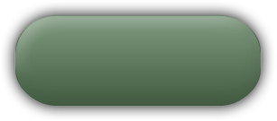
WCF Summary
Application
…
Error Behavior
Metadata Behavior
Instance Behavior
Service Model
Throttling Behavior
Transaction Behavior
Type Integ.
Behavior
Concurrency Behavior
Messaging
…
Secure
Channel
Reliable
Channel
Text/XML
Encoder
…
HTTP
Channel
TCP
Channel
Queue
Channel
Binary
Encoder
WAS
ASP.NET
WPF
WinForm
NT Service
COM+
Hosting
Environments
Notes:
Here's a roll-up of everything we've been talking about.
At the bottom of the WCF architecture, we have the hosting environments and service activation (How to spin up WCF services within a process)
Above that we have the Messaging layer for moving messages around on the wire. One aspect of the Messaging layer that we didn’t previously discuss is the message encoders. There are two types of Encoders for messages being sent from WCF services - Text/XML and Binary. If you use the HTTP protocol in conjunction with the Text/XML encoder, you get interoperability with other platforms. This is the default encoding/protocol combination. Of course, there are also optimizations that WCF services intelligently implement. For example, if an WCF service realizes that it’s communicating with another WCF service, it will use the Binary encoder to shrink packet size before sending it across the wire.
The Service Model provides the API.

Slide 32
WCF Summary
WCF is the future of distributed computing
It combines the best of all existing Microsoft distributed computing stacks
It uses WS-* standards for interoperability and .NET value-add for performance and integration with existing solutions
Generate proxy class using svcutil.exe

Slide 33
Web Services v/s WCF
ASMX Web Services | WCF
Can be hosted on IIS only | Multiple hosting options. For example, IIS, WAS, Console, WinINT Service, WCF Provided Host
Support for HTTP only | Support for HTTP, TCP, MSMQ, NamedPipes
Limited security | A consistent security programming model
Uses XmlSerializer | Uses DataContractSerializer

Slide 34
Choosing Between WCF and ASMX
Characteristic | ASMX | WCF
Development effort | ASMX requires a lower level of development skills than WCF. | WCF can require a higher level of development skills because it has a larger, more flexible programming model.
Flexibility | ASMX is accessible only through the basic HTTP transport. | With configuration, WCF service implementations can support many transport options.
Security | The ASMX security layer has fewer security features than the WCF security layer. | The WCF security layer has more security features than the ASMX security layer.
Performance | ASMX has lower performance characteristics than WCF. | WCF has higher performance characteristics than ASMX.

Slide 35
Fin.

